Slide 1
Rock paper scissors Ultimate battle of all time
By Andrew Bosco
Lewis Brant
James Nichols

Slide 2
Variable
This variable represents the amount of health a city in the game has, and the end condition is when one city condition is 0

Slide 3

Conditional statement
This condition in the damage city method would check to see if the health ever went bellow 0 , and it would allow the end condition to be satisfied

Slide 4
loops
These for loops draw the grid lines of the original field.

Slide 5
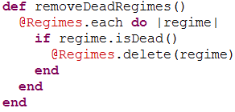
functions
This function inside of player handles the removal of regiments that are destroyed

Slide 6
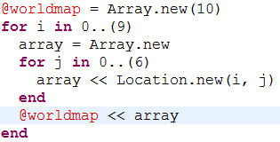
Arrays
This array, @worldmap, holds arrays of locations for the world class, this will allow the regiments and the main class to refrence were they are in the “world”

Slide 7
Graphics
This line draws the message onto the screen, and this can be a variety of different messages, from “cunning move” to “the city is under attack”

Slide 8
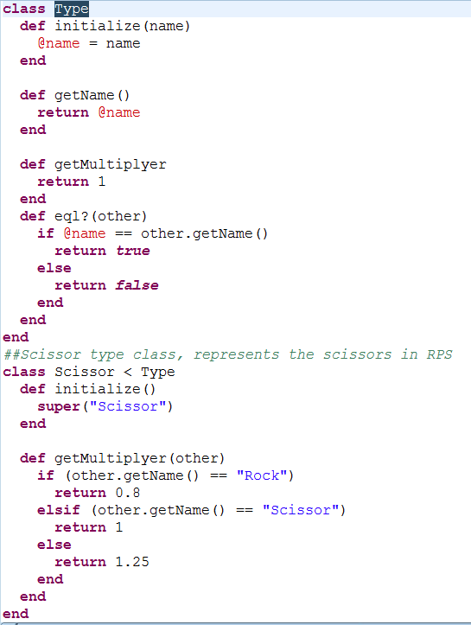
OOP design
The 2 classes shown show the object oriented technique of polymorphism, by having Scissor extend type

